Slide 1
Wiggle Animal
0856706 Susan Ku

Slide 2

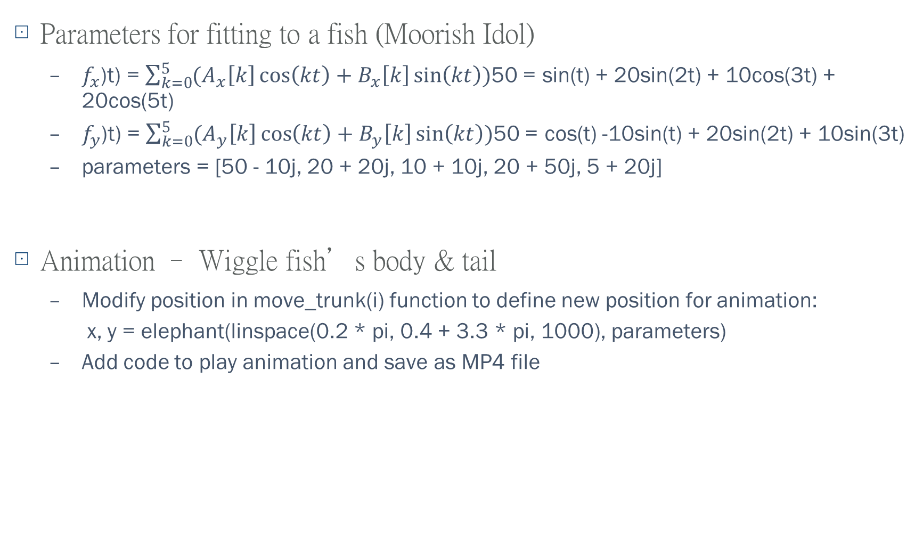
Explanation of Source Code: SDA_FittingAnimal.py
Parameters for fitting to a fish (Moorish Idol)
$f_{x}$(t) = $\sum_{k=0}^{5}{(A_{x}\left[k\right]\cos\left(kt\right)+B_{x}\left[k\right]\sin\left(kt\right))}$ = 50sin(t) + 20sin(2t) + 10cos(3t) + 20cos(5t)
$f_{y}$(t) = $\sum_{k=0}^{5}{(A_{y}\left[k\right]\cos\left(kt\right)+B_{y}\left[k\right]\sin\left(kt\right))}$ = 50cos(t) -10sin(t) + 20sin(2t) + 10sin(3t)
parameters = [50 - 10j, 20 + 20j, 10 + 10j, 20 + 50j, 5 + 20j]
Animation – Wiggle fish’s body & tail
Modify position in move_trunk(i) function to define new position for animation:
x, y = elephant(linspace(0.2 * pi, 0.4 + 3.3 * pi, 1000), parameters)
Add code to play animation and save as MP4 file

Slide 3
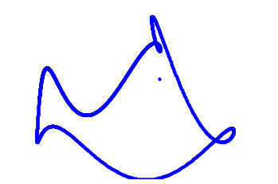
Results
Animation: https://github.com/susansfku/SDA_2020Class_Susan/blob/main/HW1_WiggleAnimal/fish_wiggle.mp4

